Slide 1






Managing Database Instance
Database Management and Administration (COMP1638)
Dr Tatiana Simmonds

Slide 2

Previously
Discussed a fundamental principle of DBMS and three level architecture
Described Oracle server architecture
Investigated various server components
Described storage structures: logical and physical
Introduced main tools for managing the database
2

Slide 3
Objectives
To learn how to start and stop the database and components
To describe the stages of database startup
To describe database shutdown options
To describe database initialization parameters
To learn how to change the values of the initialisation parameters
To discuss database listener
3

Slide 4
Managing Database Instance
Part 1

Slide 5



Terminology
Host (sometimes called server)- is a machine where database software is installed and running.
Database - is the storage of data on disk (data files, etc.)
Instance - is a combination of memory
Instance
structure and process structure.
You can have one or more databases on a server.
Each database can have one or more instances opening each database.
Instance 1
Instance 1
Instance 2
Instance 2
Instance 3
5

Slide 6


Starting up a database instance
OPEN
STARTUP
Instance opens the redo log files
and datafiles for the database
MOUNT
The instance opens the database control file, connects to the database (mounts it),
NOMOUNT
but does not open the datafiles
Instance started
The instance reads the initialization parameter file, allocates SGA memory, and starts the background processes
6

Slide 7
Startup options
OPEN
SQL> alter database open;
Instance opens the redo log files and datafiles for the database
MOUNT
The instance opens the databas e control file, connects
SQL> alter database mount;
to the database, but does not
NOMOUNT
open the datafiles
The instance reads the initialization parameter file, allocates SGA memory, and starts the background processes
SQL> startup nomount;
SQL> startup;
7

Slide 8

Instance shutdown
Users can no longer access the database.
Modified data blocks cached in the SGA are written to a disk. The contents of the redo log buffer are written to a disk, and then the redo log buffer is cleared. A checkpoint is performed. Datafiles and log files are closed.
CLOSED
SHUTDOWN
The instance dismounts the database and updates relevant entries in the control file to record a clean shutdown. The control file is closed. The database is now closed and dismounted.
DISMOUNT
The Oracle instance stops the background processes and de- allocates the shared memory used by the SGA.
SQL> shutdown; Database closed. Database dismounted.
ORACLE instance shut down.
Instance stopped
8

Slide 9
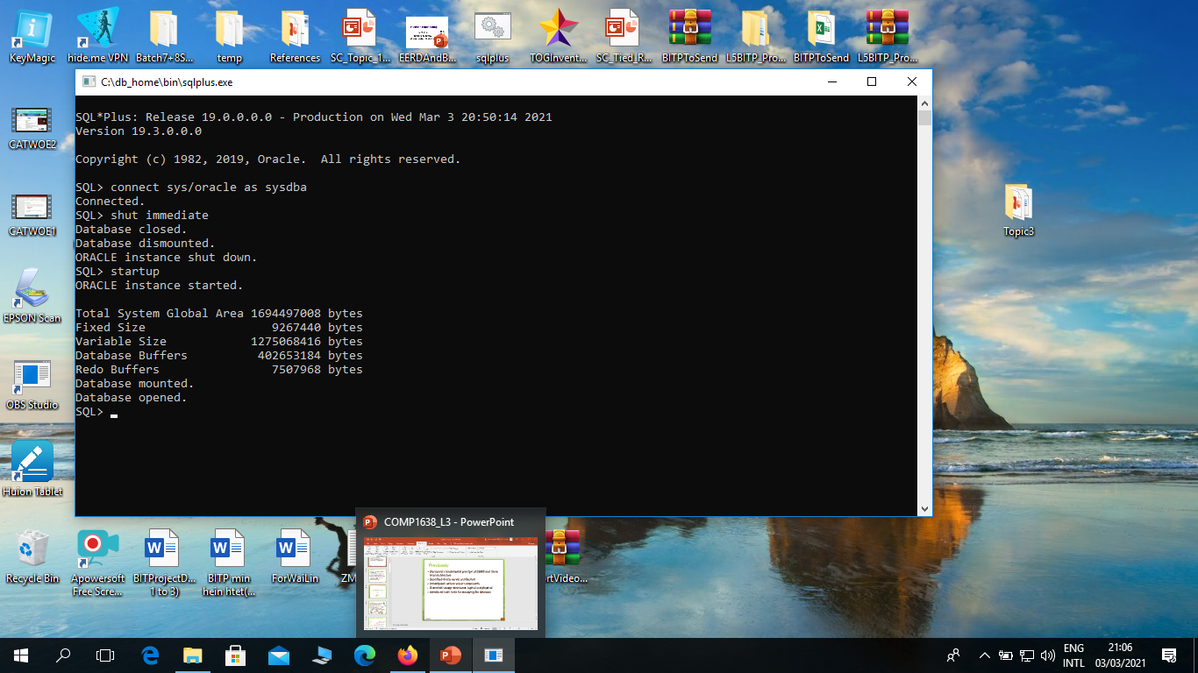

Slide 10
Shutdown modes
There are different shutdown modes:
ABORT:
Performs the least amount of work before shutting down. Because this mode requires recovery before startup, use it only when necessary. It is typically used when no other form of shutdown works, or when you need to shut down immediately because of an impending situation (such as notice of a power outage within seconds).
IMMEDIATE: Is the most typically used option. Uncommitted transactions are rolled back.
TRANSACTIONAL: Allows transactions to finish.
NORMAL: Waits for sessions to disconnect.
ABORT is the fastest and NORMAL is the slowest.
NORMAL and TRANSACTIONAL can take a long time depending on the number of sessions and transactions.
10

Slide 11
Shutting down
a database instance in SQL*Plus
SHUTDOWN [NORMAL | TRANSACTIONAL | IMMEDIATE | ABORT ]
SQL> shutdown;
the same
SQL> shutdown normal;
SQL> shutdown transactional; SQL> shutdown immediate; SQL> shutdown abort;
11

Slide 12
Shutdown modes
Shutdown Modes | A | I | T | N
Allows new connections | No | No | No | No
Waits until current sessions end | No | No | No | Yes
Waits until current transactions end | No | No | Yes | Yes
Forces a checkpoint and closes files | No | Yes | Yes | Yes
Shutdown modes:
A = ABORT
I = IMMEDIATE
T = TRANSACTIONAL
N = NORMAL
T.Simmonds
11

Slide 13
Question:
What is the fastest and safe shutdown
mode?
T.Simmonds
12

Slide 14
Managing Database Instance
Part 2

Slide 15

Initialization parameters
Managing an instance includes configuring parameters that affect the basic operation of the instance
These parameters are called initialization parameters.
The instance reads initialization parameters from a file at startup
After being read from a file, initialization parameters are retained in memory, where the values for many of them can be changed dynamically
There are two types of files from which these parameters can be read:
a text initialization parameter file init<SID>.ora
a server parameter file spfile<SID>.ora
Question: What is SID – (System Identifier) of the database?
15

Slide 16


Server parameter file
Server parameter file (SPFILE):
is the preferred type of initialization parameter file,
is a binary file,
can be written to and read by the database server,
X
must not be edited manually,
resides on the server on which the Oracle instance is executing,
is persistent across shutdown and startup,
The default name of this file, which is automatically sought at startup, is spfile<SID>.ora
16

Slide 17

Text initialization parameter file
Text initialization parameter file:
can be read by the database server, but it is not written to by the server.
parameter settings must be set and changed manually by using a text editor
The default name of this file (which is automatically sought at startup if an SPFILE is not found) is init<SID>.ora
To create text initialisation file from server parameter file
use:
SQL> create pfile from spfile;
To create server parameter file from text init file use:
SQL> create spfile from pfile;
T.Simmonds
1
6

Slide 18
Types of initialization parameters
There are two kinds of initialization parameters:
Static - cannot be changed for the current instance. You must change these parameters in the text initialization file or server parameter file and then restart the database before changes take effect.
Dynamic - can be changed for the current Oracle Database instance. The changes take effect immediately. There are two types:
Session-level parameters affect only a user session; they expire when the session ends (for example, national language support (NLS) parameters that specify national language settings, etc.)
System-level parameters affect the entire database and all sessions. These parameters stay in effect based on the SCOPE specification. Examples include modifying the SGA_TARGET value.
Dynamic parameters can be changed by using the ALTER SESSION and ALTER SYSTEM SQL commands
T.Simmonds
17

Slide 19
Other types of initialization parameters
Initialization parameters can also be:
Basic - parameters that should be considered for every database.
Advanced - extra parameters, that the most databases run well with default values.
Derived , meaning that their values are calculated from the values of other parameters (Normally, you should not alter values for derived parameters).
Operating system dependent, meaning their value depend on the host operating system.
Viewing initialisation parameter values in SQL*Plus:
SQL> SELECT name , value FROM
NAME VALUE
V$PARAMETER;
lock_name_space processes sessions timed_statistics
…
2
150
170
TRUE
T.Sim
monds
18

Slide 20
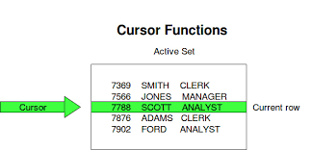
About Cursor
When Oracle Database executes a SQL statement, it stores the result set and
processing information in an unnamed private SQL area. A pointer to this
unnamed area, called a cursor, lets you retrieve the result set one row at a time.
Cursor attributes return information about the state of the cursor.
A cursor variable is like a cursor that it is not limited to one query. You can open
a cursor variable for a query, process the result set, and then use the cursor
variable for another query. Cursor variables are useful for passing query results
between subprograms.

Slide 21
Viewing initialization parameters in EM

Slide 22
Changing initialization parameters
 The SCOPE clause in ALTER SQL command allows to specify when the change takes effect.
MEMORY indicates that the change is made in memory, takes effect immediately, and persists until the database is shut down.
SPFILE indicates that the change is made in the server parameter file. The new setting takes effect when the database is next shut down and started up again.
BOTH indicates that the change is made in memory and in the server parameter file.
 Static parameters:
Can be changed only in the parameter file
ALTER SYSTEM SET parameter_name=value SCOPE=SPFILE;
 Dynamic parameters:
Can be changed while database is online or in the parameter file ALTER SYSTEM SET parameter_name=value SCOPE=MEMORY; ALTER SYSTEM SET parameter_name=value SCOPE=SPFILE; ALTER SYSTEM SET parameter_name=value SCOPE=BOTH;

Slide 23
Managing Database Instance
Part 3

Slide 24


Connecting to the Database
Connect User_name/password @database
User process
Server process
User
SQL> Select
Listener
Connection: Communication between a user process and an instance.
Session: Specific connection of a user to an instance through a user process.

Slide 25

What is the Listener?
Oracle Net Listener (or simply the Listener)
is the gateway to the Oracle instance for all ‘networked’ user connections.
is responsible for coordinating connections between the database and external applications.
A single listener can service multiple database instances and thousands of client connections.
You can control the configuration of the actual
listener.
Oracle Net configuration files
<oracle_home>/network/admin/listener.ora
<oracle_home>/network/admin/tnsnames.ora

Slide 26
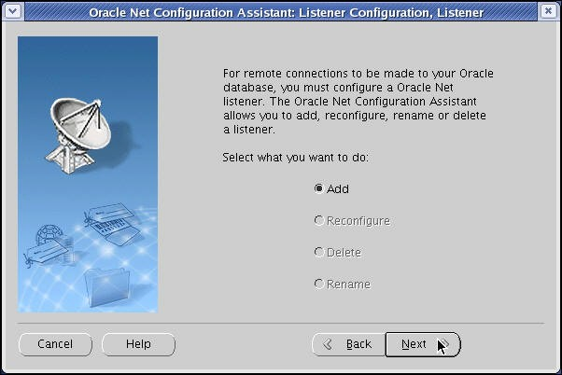
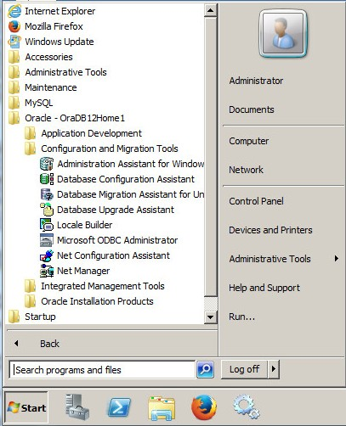
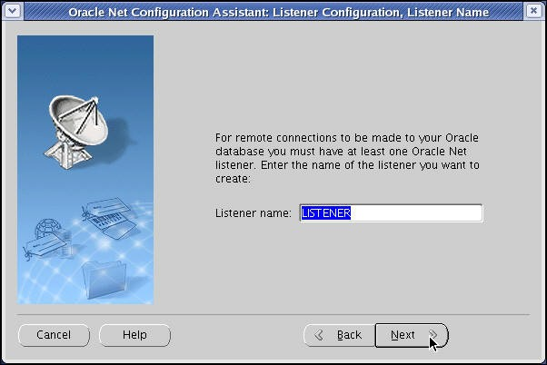
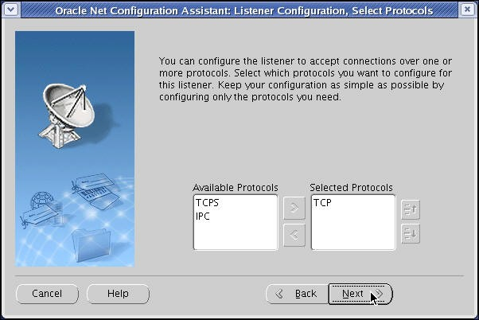
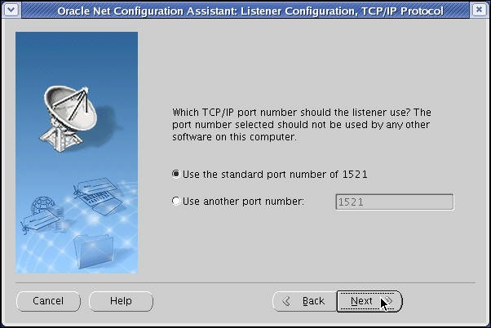
Configuring the Listener
<oracle_home>/network/admin/listener.ora
<oracle_home>/network/admin/tnsnames.ora

Slide 27
Using the Listener Control Utility
Use the following commands to control the listener:
Starting the listener:
 Example:
Stopping the listener:
 Example:
lsnrctl START listener_name
lsnrctl START LISTENER
lsnrctl STOP listener_name
lsnrctl STOP LISTENER
Checking status of the listener:
lsnrctl STATUS
 Example:
lsnrctl STATUS LISTENER
T.Simmonds

Slide 28
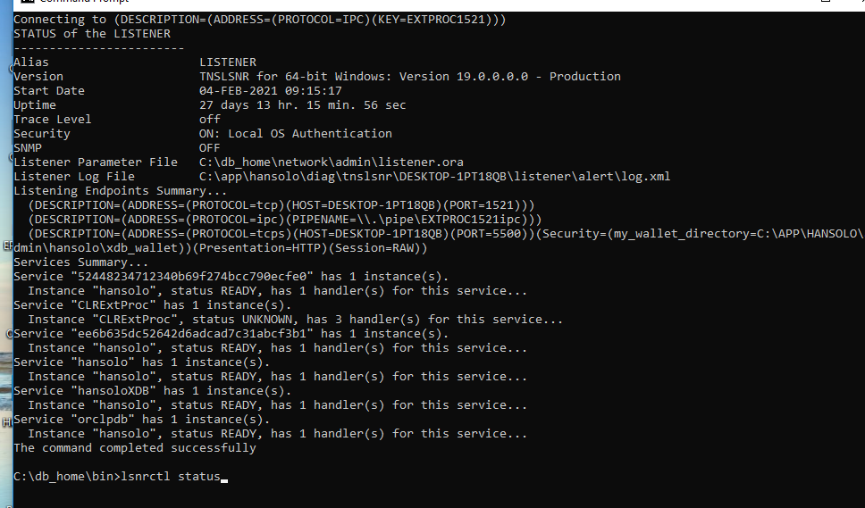

Slide 29
Interacting with a Database
An instance has started on a machine where Oracle Database is installed often called the host or database server. The server also runs a listener that has the appropriate Oracle Net Services handler.
A user starts an application spawning a user process, which attempts to establish a connection to the server.
The listener detects the connection request from the application and creates a dedicated server process on behalf of the user process.
4. User process communicates with the server
. . .
process.
T.Simmonds

Slide 30
Essentials
Describe database initialization parameters
Learn how to change the values of the initialisation parameters
Start and stop the database and components
Describe the stages of database startup
Describe database shutdown options
Discuss database listener
T.Simmonds
27

